Slide 1

How a Computer Works
Imagine a computer as a collection of parts working together to process information.

Slide 2
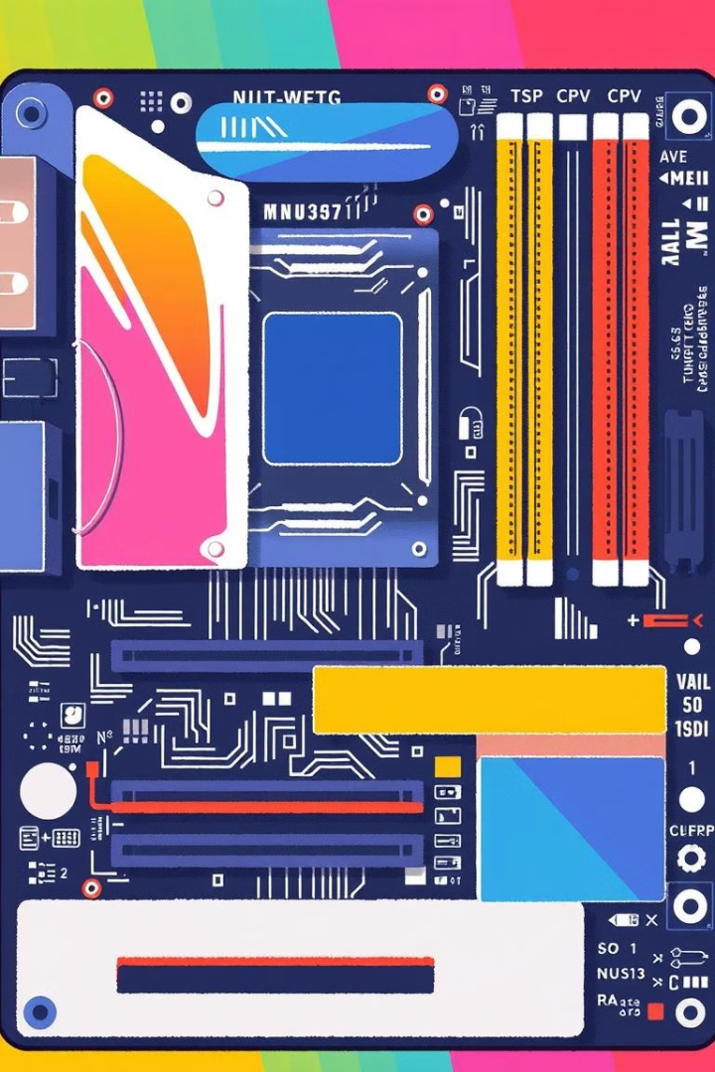
Components of a Computer
Input Devices
Central Processing Unit (CPU)
Devices that allow you to give instructions to the computer.
The brain of the computer, responsible for processing instructions.
Memory (RAM and Storage)
Output Devices
Devices that display the results of processing.
Temporary and permanent storage for data and instructions.

Slide 3
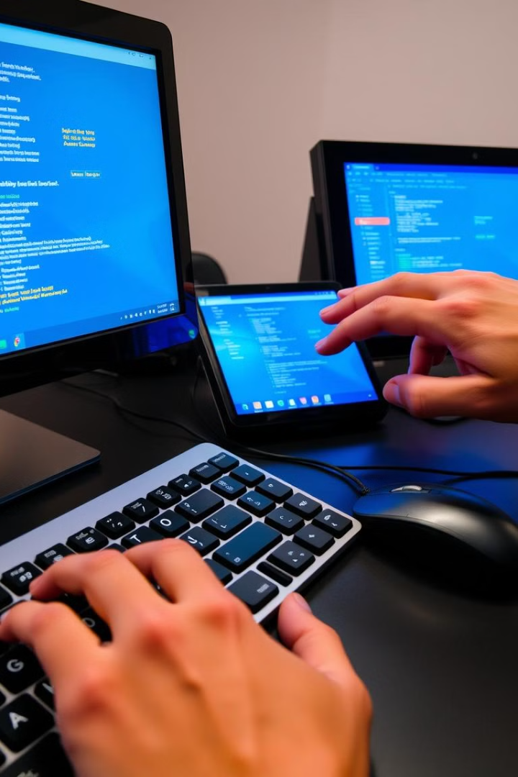
Input Devices
1
Keyboard
2
Mouse
Used to type in text or commands.
Used to move a pointer on the screen.
3
Touchscreen
4
Microphone
Allows direct interaction with the computer screen.
Used to record audio.

Slide 4
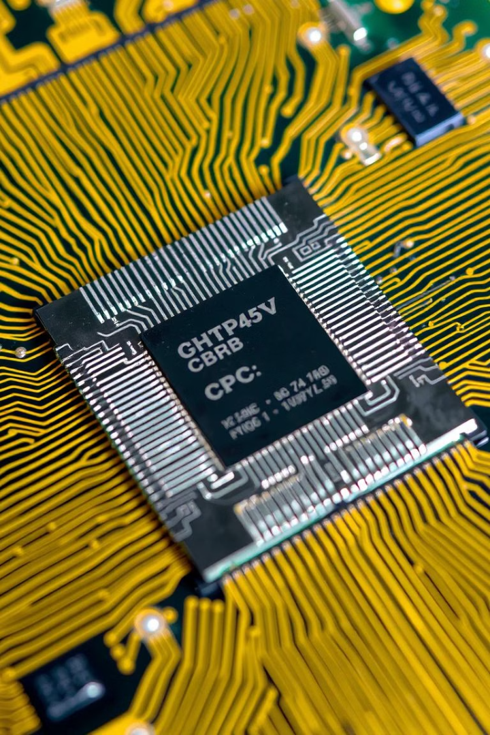
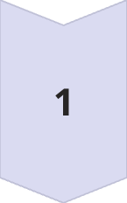
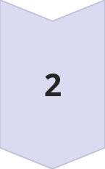
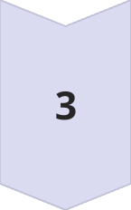
Central Processing Unit (CPU)
Execution Unit
Processes instructions.
Control Unit
Manages the flow of data and instructions.
Cache
Stores frequently used data for quick access.

Slide 5
Memory (RAM and Storage)
RAM (Random Access Memory)
Storage
Fast, temporary storage for data and instructions that the CPU is currently using.
Permanent storage for files, programs, and operating systems.

Slide 6
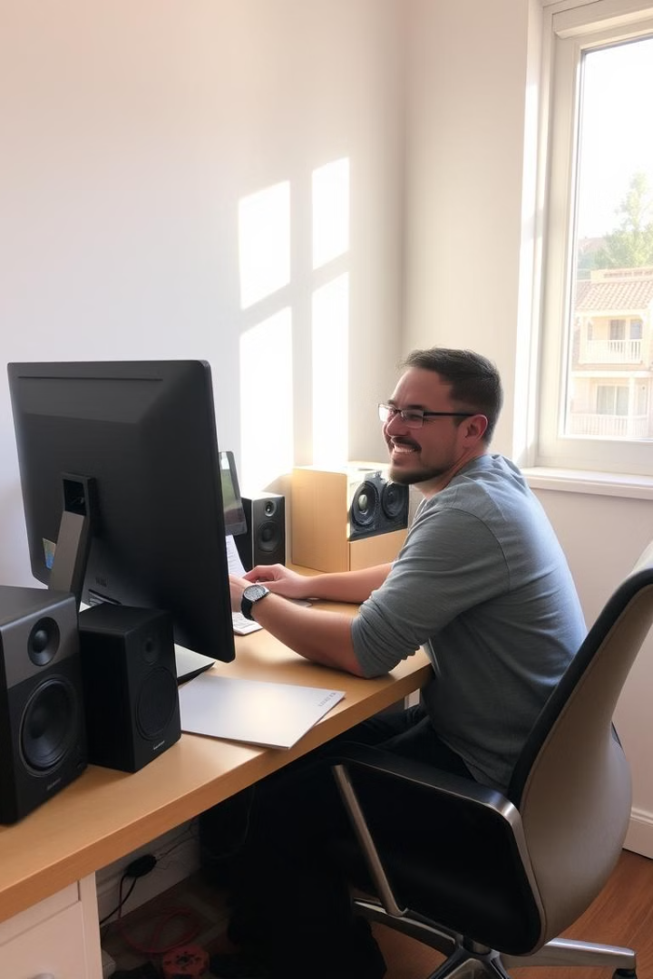



Output Devices
Monitor
Displays visual information.
Printer
Prints documents and images.
Speakers
Produce sound.

Slide 7
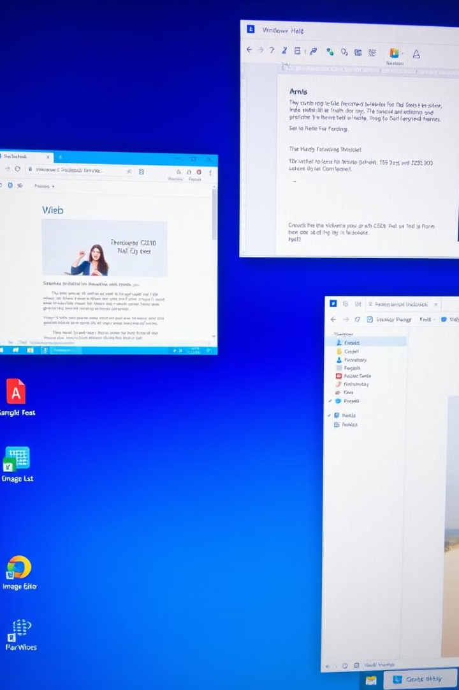
Software and Operating Systems
1
Software
Programs that instruct the computer to perform specific tasks.
2
Operating System (OS)
Manages the hardware and provides a user interface.

Slide 8
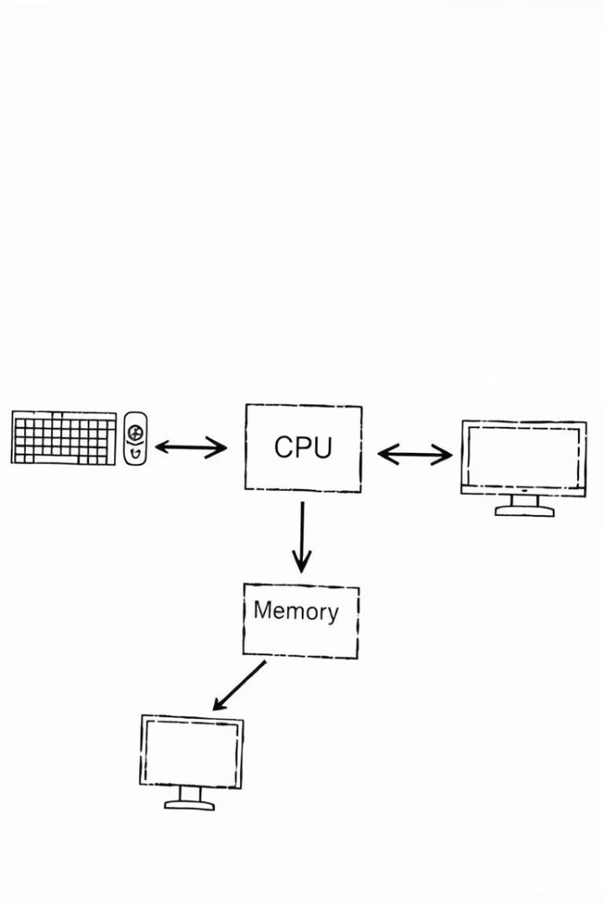
Putting it All Together
Input devices send instructions to the CPU, which processes them using data from memory. Results are then displayed on output devices.

